Slide 1

Zomato Expansion Strategy: A Data-Driven Odyssey
Unlocking Untapped Markets Beyond India
Yuvraj Gupta
11/08/2025

Slide 2
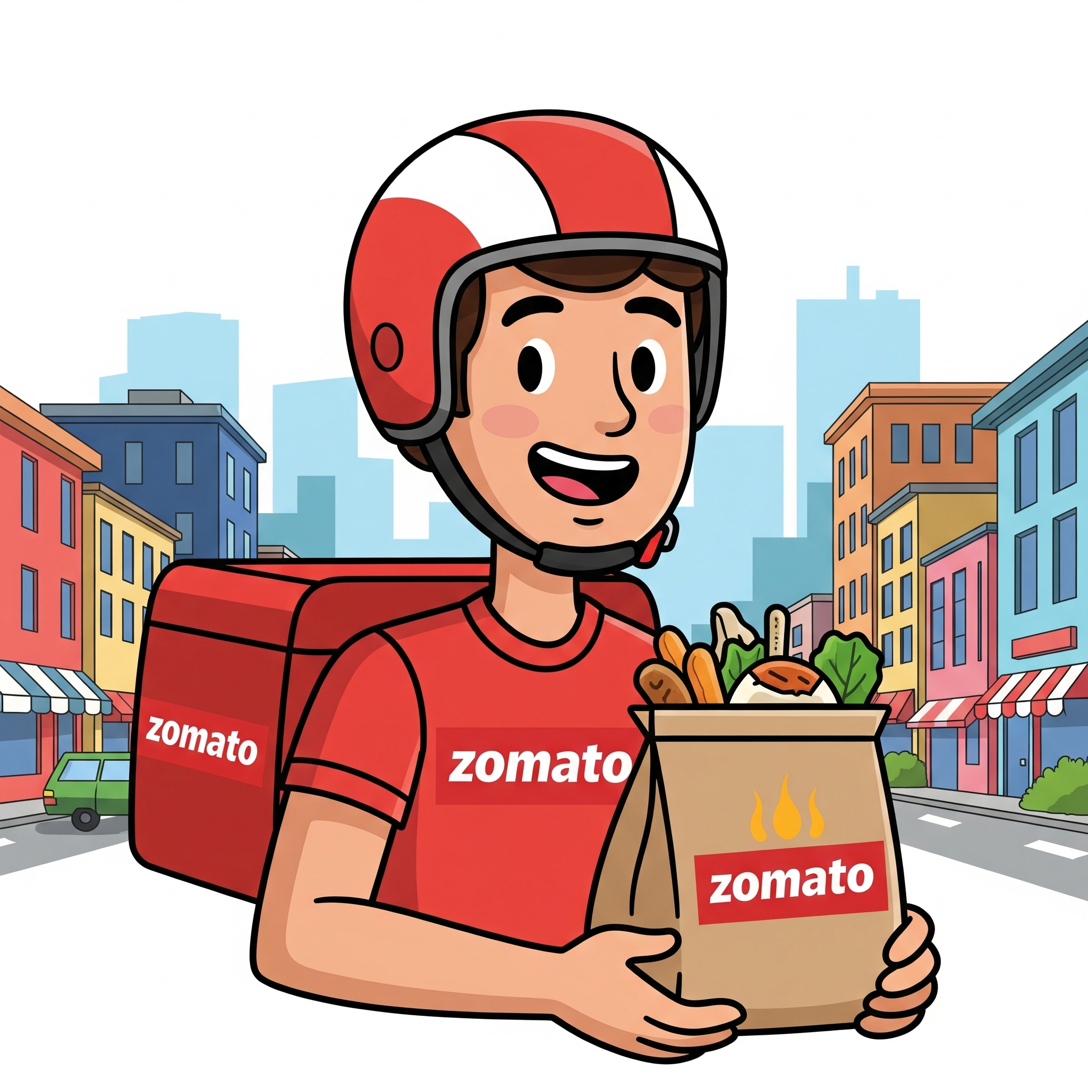
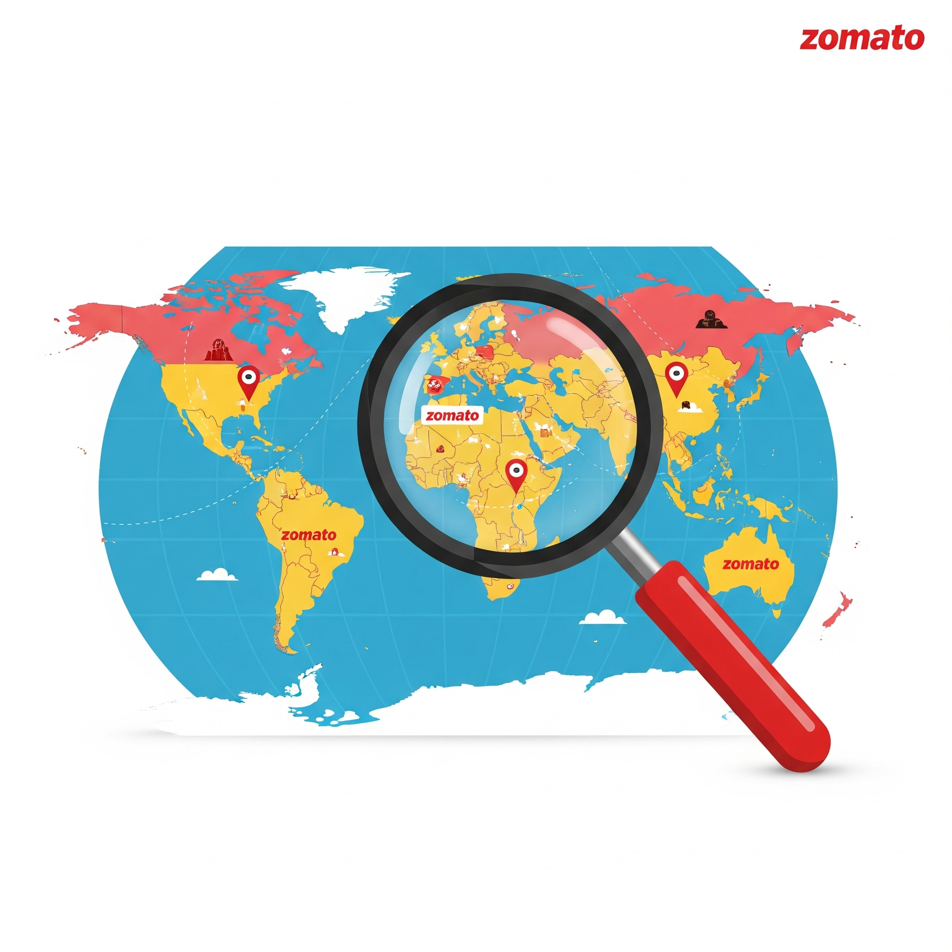
Problem Statement
Identify high-potential locations and strategies for Zomato’s new restaurant openings using data-driven analysis.

Slide 3
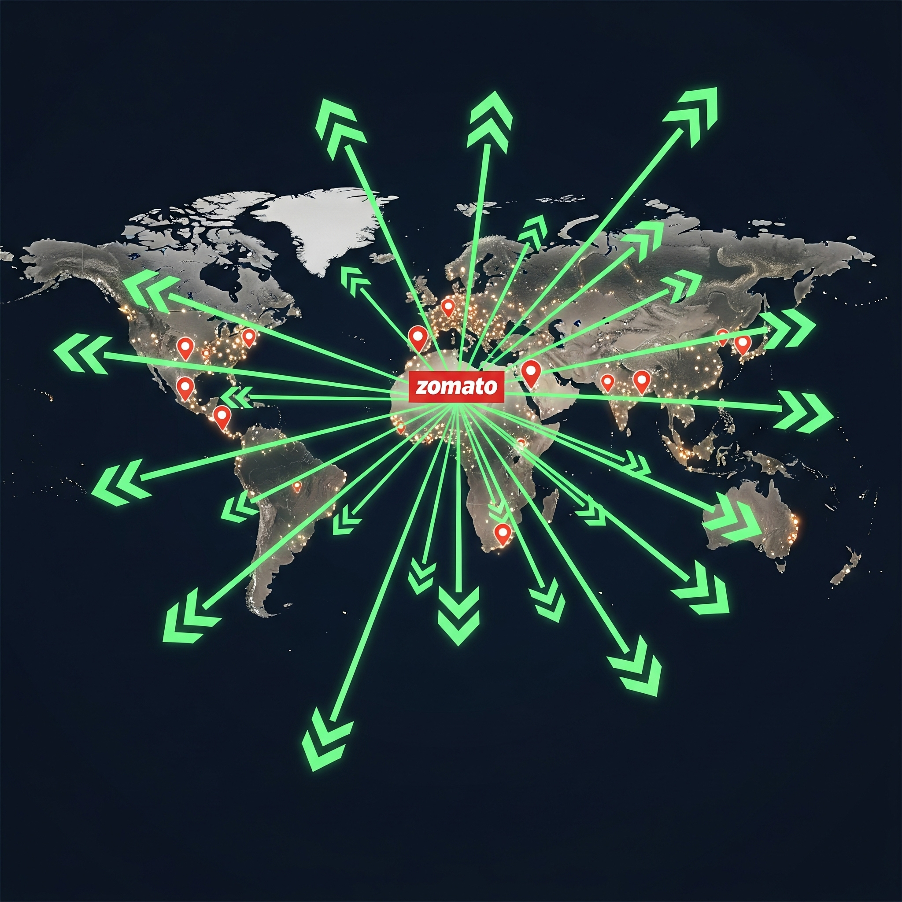
Zomato: Strategic Expansion Roadmap
Where should Zomato expand next?
Australia,Sri Lanka,Singapore,Canada
Target high-potential, underserved markets
Focus on low competition and unmet demand
Opportunity in online delivery gaps and mid-range ratings

Slide 4
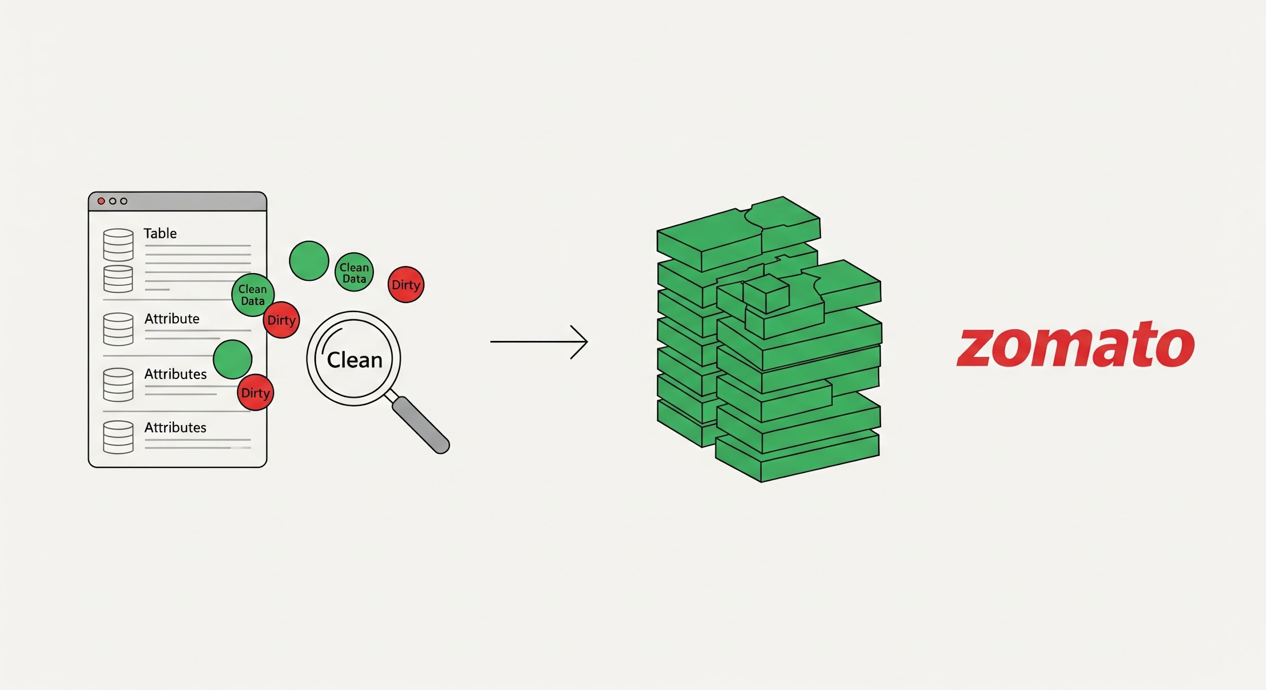
Data at a Glance: Fueling Strategic Decisions
Our analysis is built upon a robust dataset providing comprehensive insights into Zomato's operations and the global restaurant landscape.
2 datasets: Restaurant data & Country descriptions
20+ features including Ratings, Cuisines, Delivery
Cleaned nulls (e.g., missing cuisines filled as "North Indian")
No duplicate values found
Created additional fields for analysis (e.g., Cost in INR)

Slide 5
Our Analytical Approach
Phase 1: Building a Strong Data Foundation
Data Acquisition: Collected comprehensive Zomato and market data from multiple sources.
Data Cleaning: Ensured integrity by removing duplicates and addressing missing values, standardizing for accuracy.
Data Enrichment: Integrated datasets to create a robust base for analysis.

Slide 6
Our Analytical Approach
Phase 2: Strategic Market Analysis
Market Opportunity: Identified regions with low Zomato presence and high potential for expansion (e.g., Canada, Qatar, Singapore, Sri Lanka).
Customer Insights: Analyzed spending trends and restaurant distribution to align with local preferences and highlight underserved segments.
Competitive Assessment: Evaluated top competitors and low-rated players to identify service gaps and refine positioning.
Service Optimization: Assessed the impact of cuisine types and delivery models on customer satisfaction to inform operational strategy.
Price-Rating Dynamics: Explored the link between pricing and ratings to guide optimal pricing and perception.

Slide 7
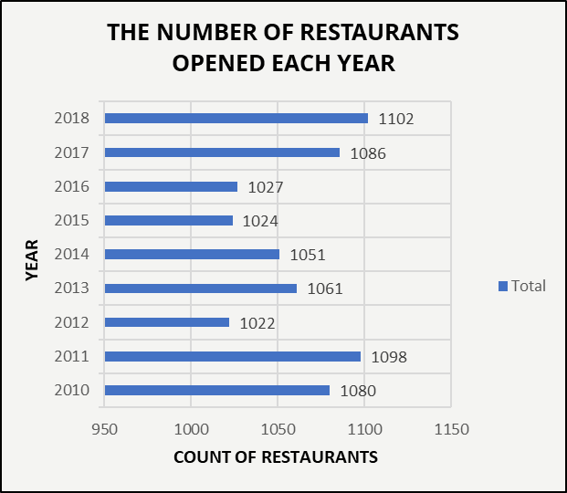
Market Consistency & Opportunity (2010–2018)
Zomato’s potential expansion is backed by market momentum
1,000+ new restaurants/year
Peaks in 2011 & 2018
Shows strong demand & low expansion risk
Analyst Insight:
A reliable pace of new restaurant launches signals a mature yet receptive market—creating favorable conditions for both established brands and new players to expand strategically.

Slide 8
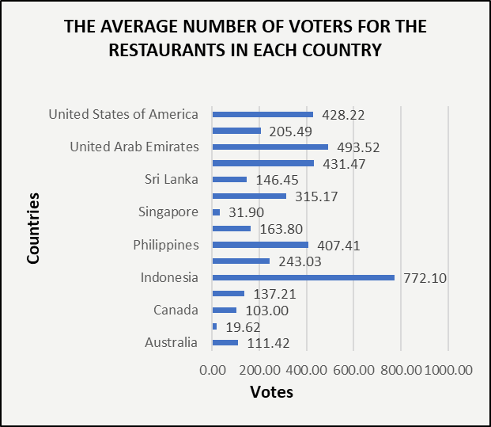
Customer Engagement: Identifying Vocal Opportunity Markets
To understand customer interaction, we analyzed the average number of voters per restaurant, a key indicator of market engagement.
The data reveals that some markets have exceptional "vocal" customers:
Philippines: 500.73 average voters
Indonesia: 458.38 average voters
United Arab Emirates: 444.13 average voters
Strategic Insight: These highly engaged markets are perfect for launching new restaurants, as customers are more likely to provide valuable feedback and generate word-of-mouth buzz.

Slide 9
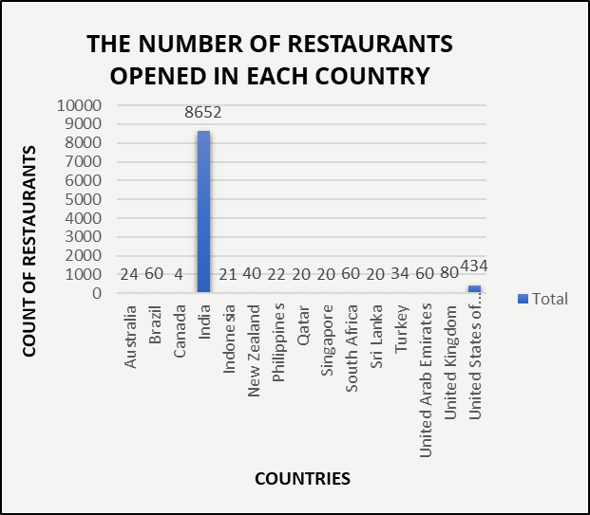
Global Footprint: Market Concentration(Outside India)
Current State: High Concentration, Limited Global Spread
Key Findings:
India leads: 8,652 locations
International presence is limited:
US: 434
UK: 80
Brazil: 60
Strategic Implication: This heavy reliance on one market highlights the critical need to diversify our operations and expand into new growth markets.
Note:
India is excluded from the chart due to its outsized count. This ensures clearer comparison of non-India markets and highlights the need for global expansion

Slide 10
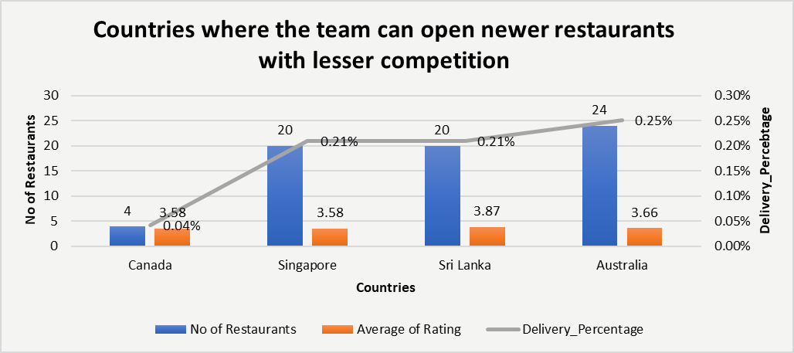
Strategic Market Selection: Unlocking Untapped Potential
Focusing Expansion Where It Matters Most
Australia, Canada, Singapore, Sri Lanka
Fewer restaurants = less competition
Mid-range ratings = demand + room to grow
Low online delivery = Zomato advantage
Targeted expansion = early mover edge
Expanding into these underserved and less competitive markets allows Zomato to capture early mover advantage, build brand loyalty, and shape the trajectory of online food delivery in new regions. This data-driven approach supports sustainable international growth while reducing overreliance on saturated markets.

Slide 11
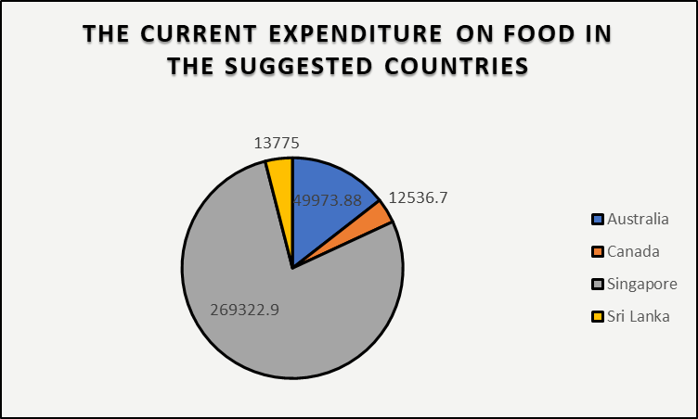
Financial Blueprint: Target Market Cost Analysis
Budgeting for Strategic, Profitable Expansion
Singapore: Highest avg cost for two
Australia: Mid-tier
Canada & Sri Lanka: Lean investment options
All costs standardized in INR
Use cost tiers to match entry strategy

Slide 12
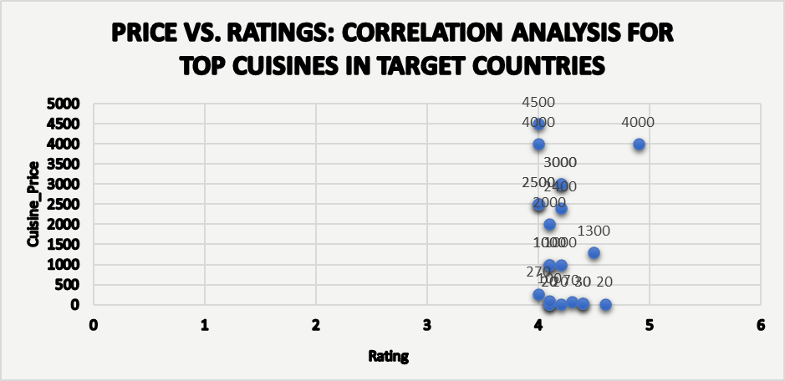
Price vs. Ratings: The Correlation Myth
Decoupling Price from Customer Satisfaction
Core Insight: Higher menu prices do not ensure greater customer satisfaction. Data across markets shows no consistent relationship between spending and customer ratings (see scatter plot).
Business Relevance: Sustainable success and market leadership are driven by consistently creating value and exceeding customer expectations, fostering loyalty through memorable experiences and service rather than relying solely on price as a differentiator.

Slide 13
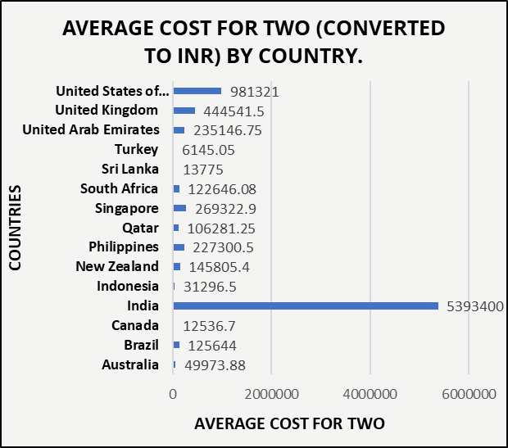
How Much Does Dining Out Cost Around the World?
A data-driven look at the financial landscape across global markets
Strategic Takeaways:
India's bar looks huge due to the number of entries, but for expansion, we focus on:
🇸🇬 Singapore – Higher food cost → Requires stronger ROI strategy
🇦🇺 Australia – Moderate expenditure → Mid-investment market
🇱🇰 Sri Lanka & 🇨🇦 Canada – Affordable → Low-risk entry
Zomato can use this to prioritize market entry by budget tiers

Slide 14
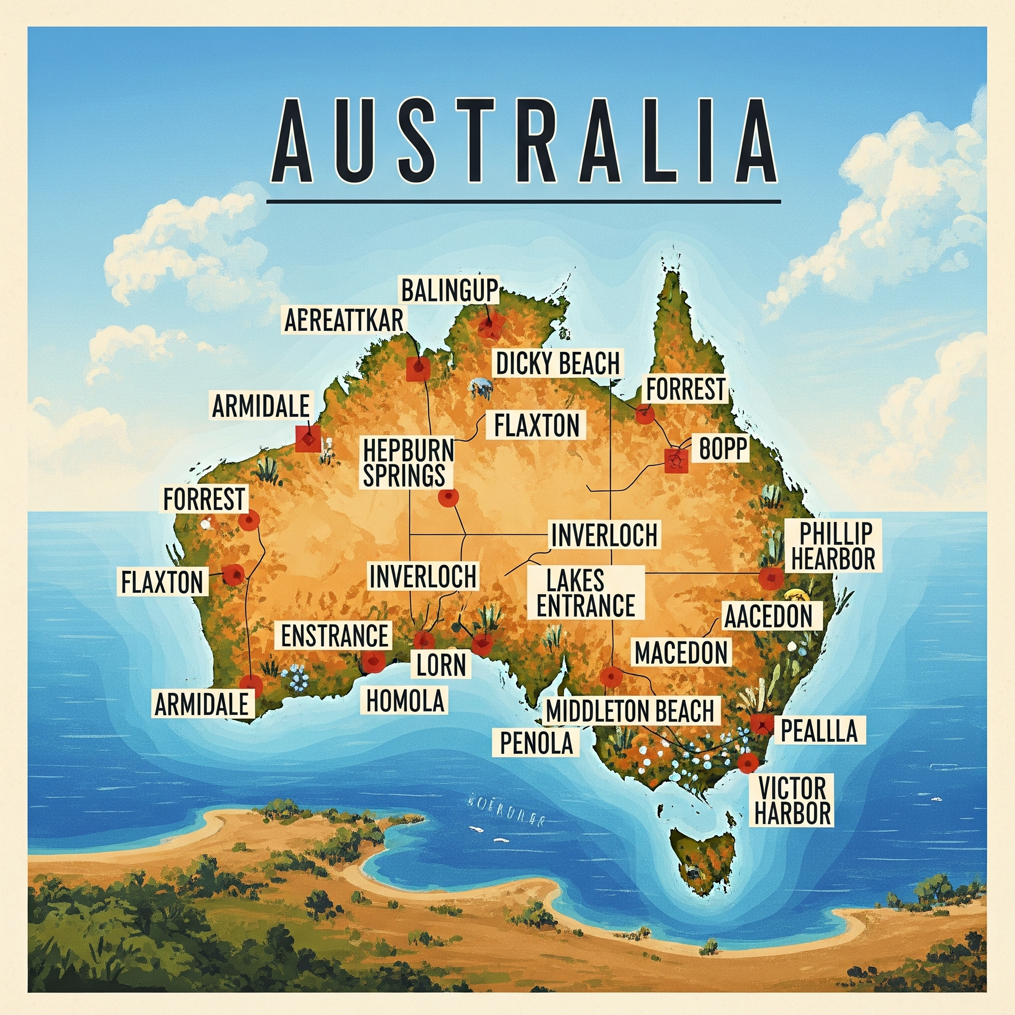
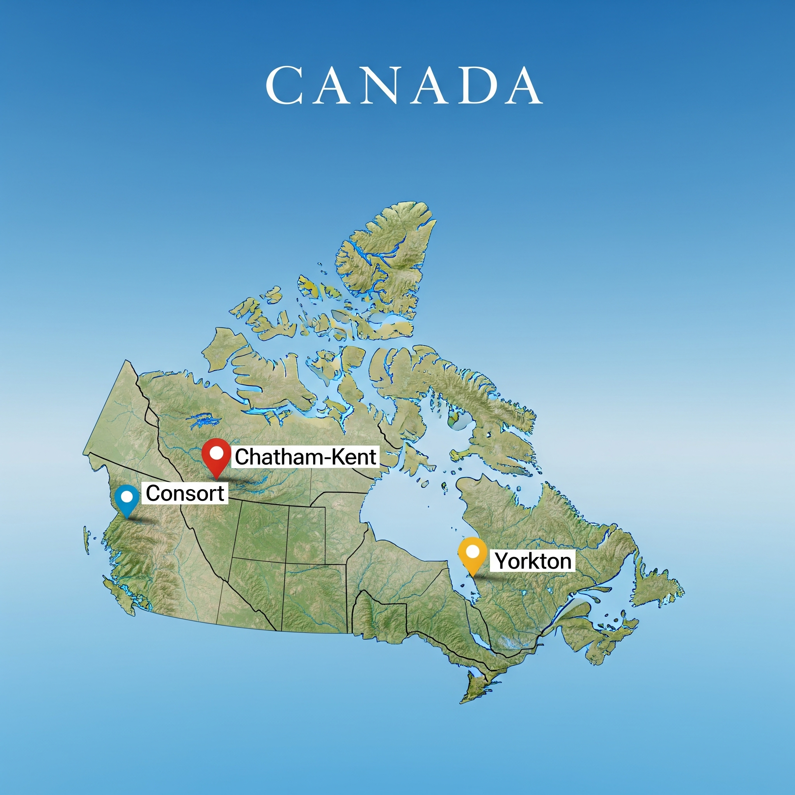

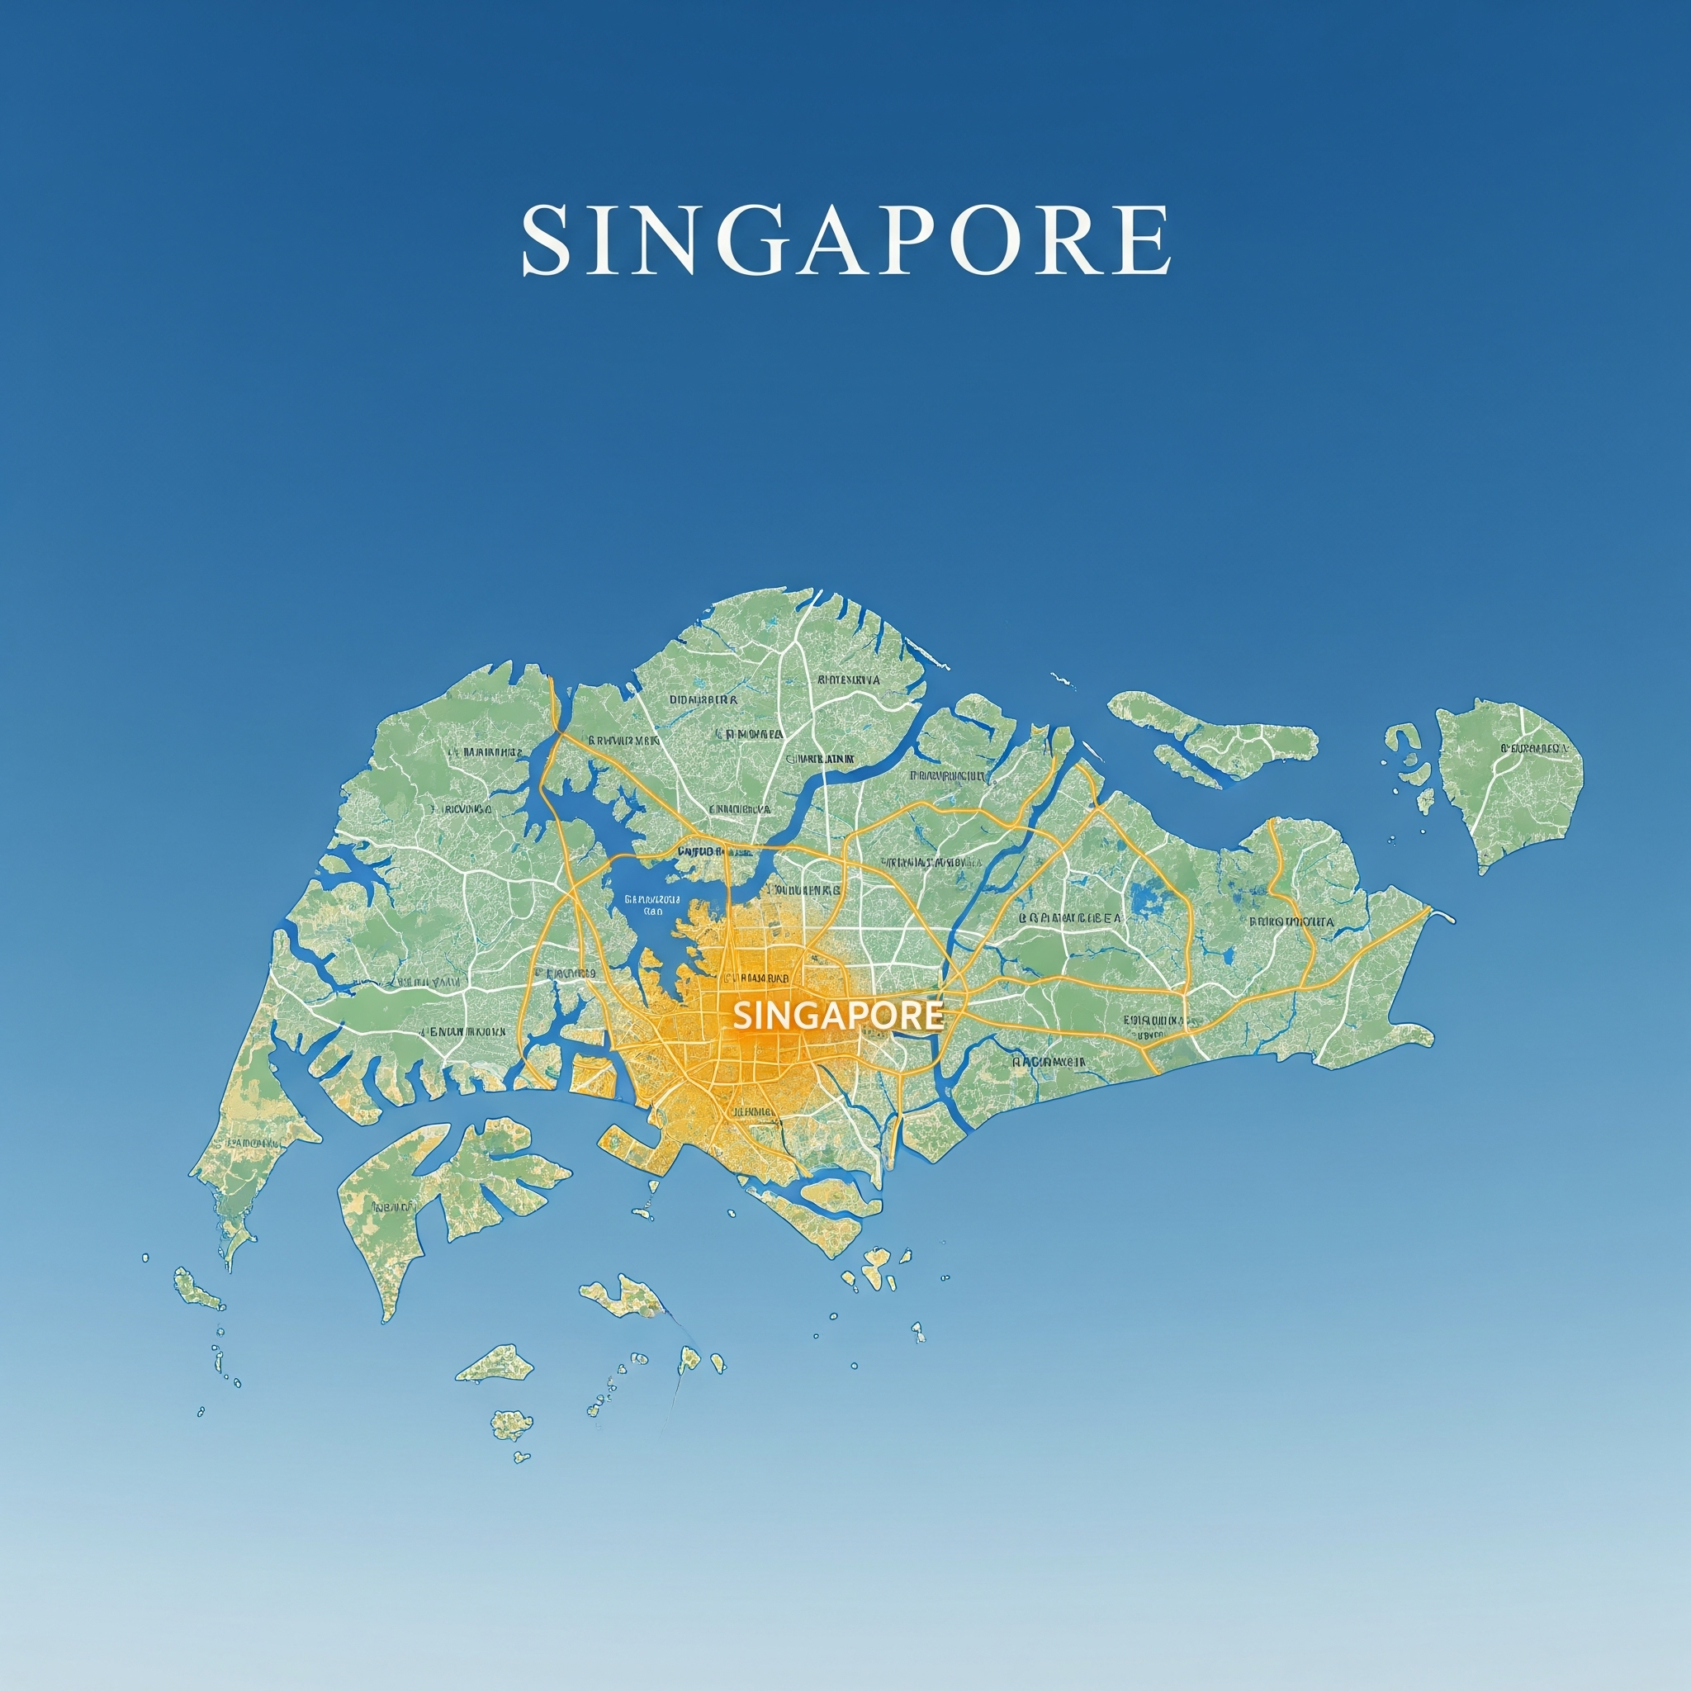
Best Cities for Launch
Which cities meet our ideal profile?
Data-Driven Reason: Cities like Armidale, Chatham-Kent, Singapore (city), and Colombo offer healthy opportunities due to less saturation, fair customer sentiment (ratings between 3-4), and limited online delivery options. Some even have as few as two restaurants, which is still manageable from a competition standpoint.
Expected Impact: Tapping into markets with existing demand but limited modern services allows Zomato to stand out by offering
superior online delivery and overall customer experience.

Slide 15
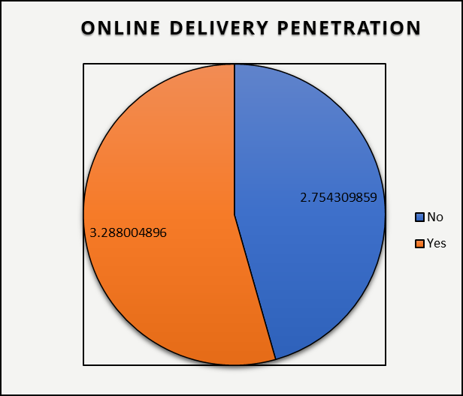
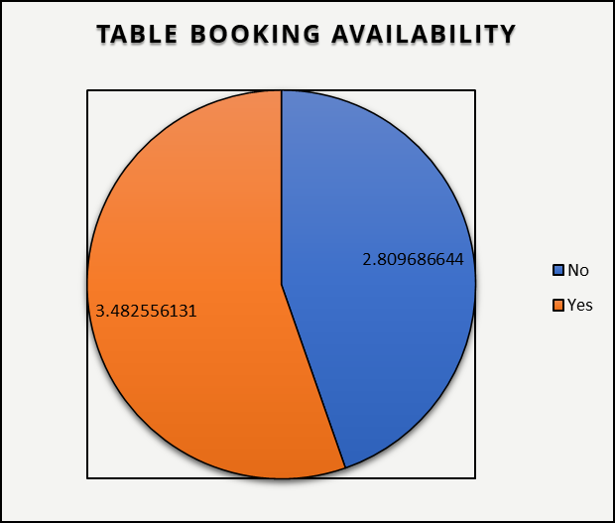
Enhancing Service Quality and Customer Experience
Recommendation: Position online delivery and table booking as essential features in all new restaurants.
The charts clearly show one message:
Online delivery and table booking are crucial for transforming customer perception and enhancing the dining journey, leading to stronger ratings and outperforming restaurants that do not offer these convenient services.
Expected Business Impact:
Stronger Brand Loyalty: Customers are more likely to return to a restaurant that respects their time and preferences.
Positive Reputation Growth: Better experiences translate into recommendations and organic promotion.
Competitive Advantage: Sets the restaurant apart in markets where convenience is a deciding factor.

Slide 16
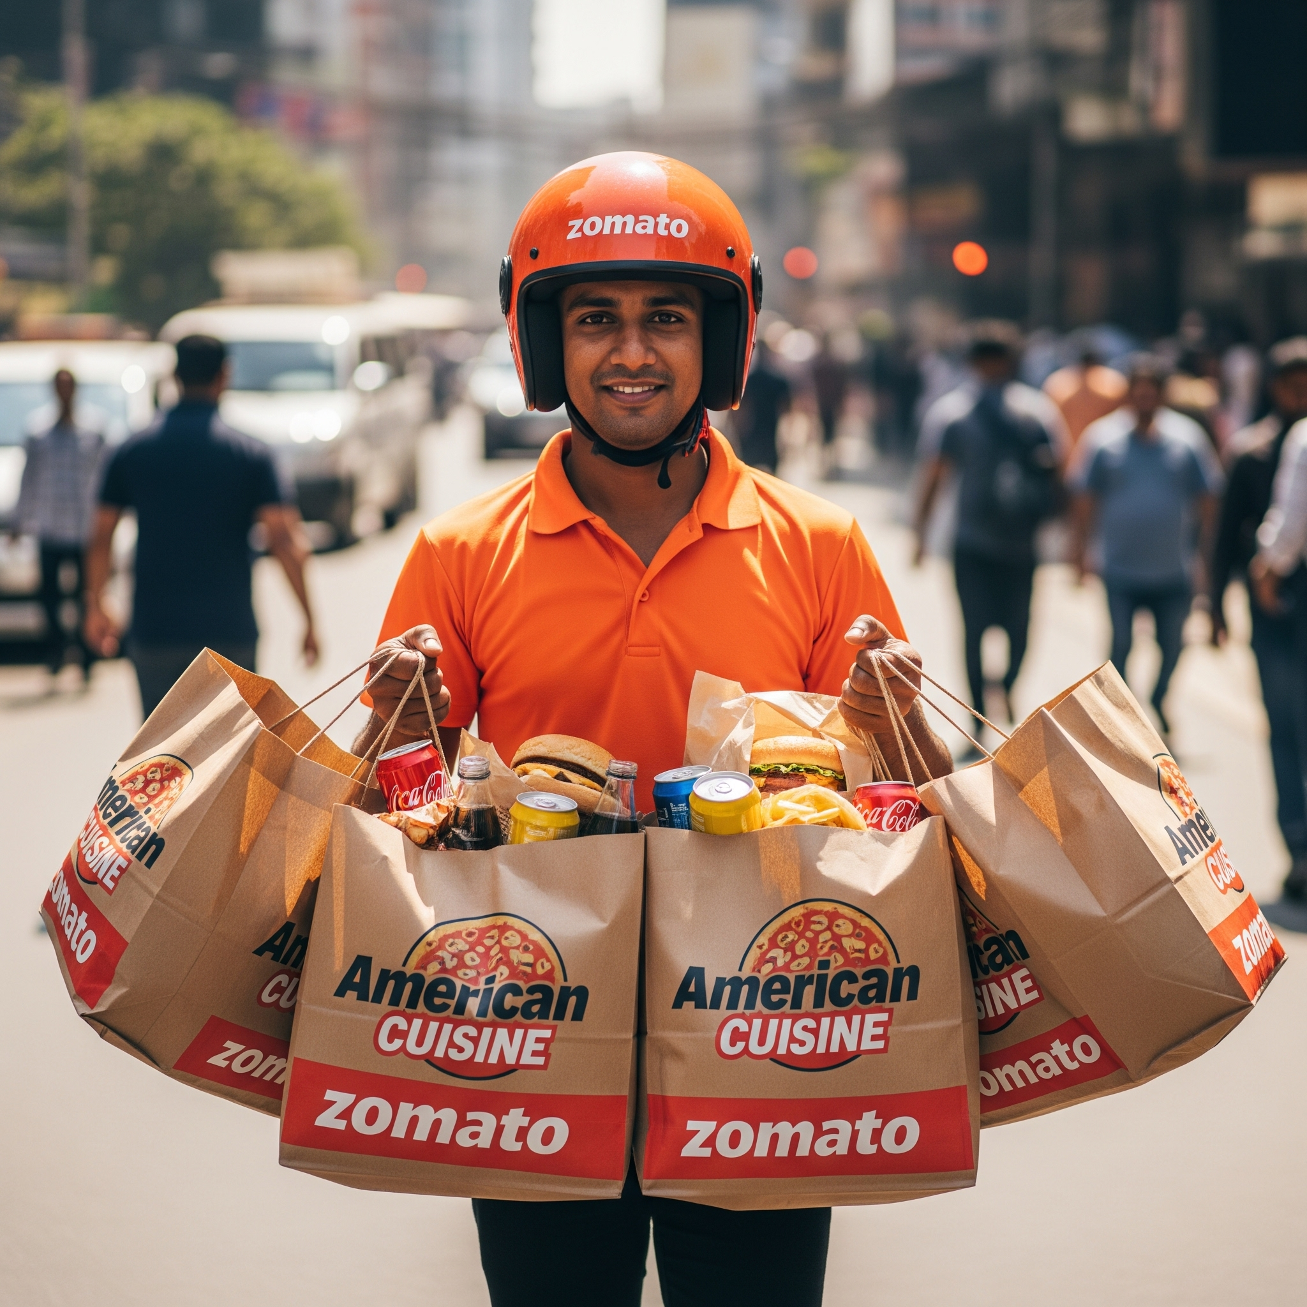
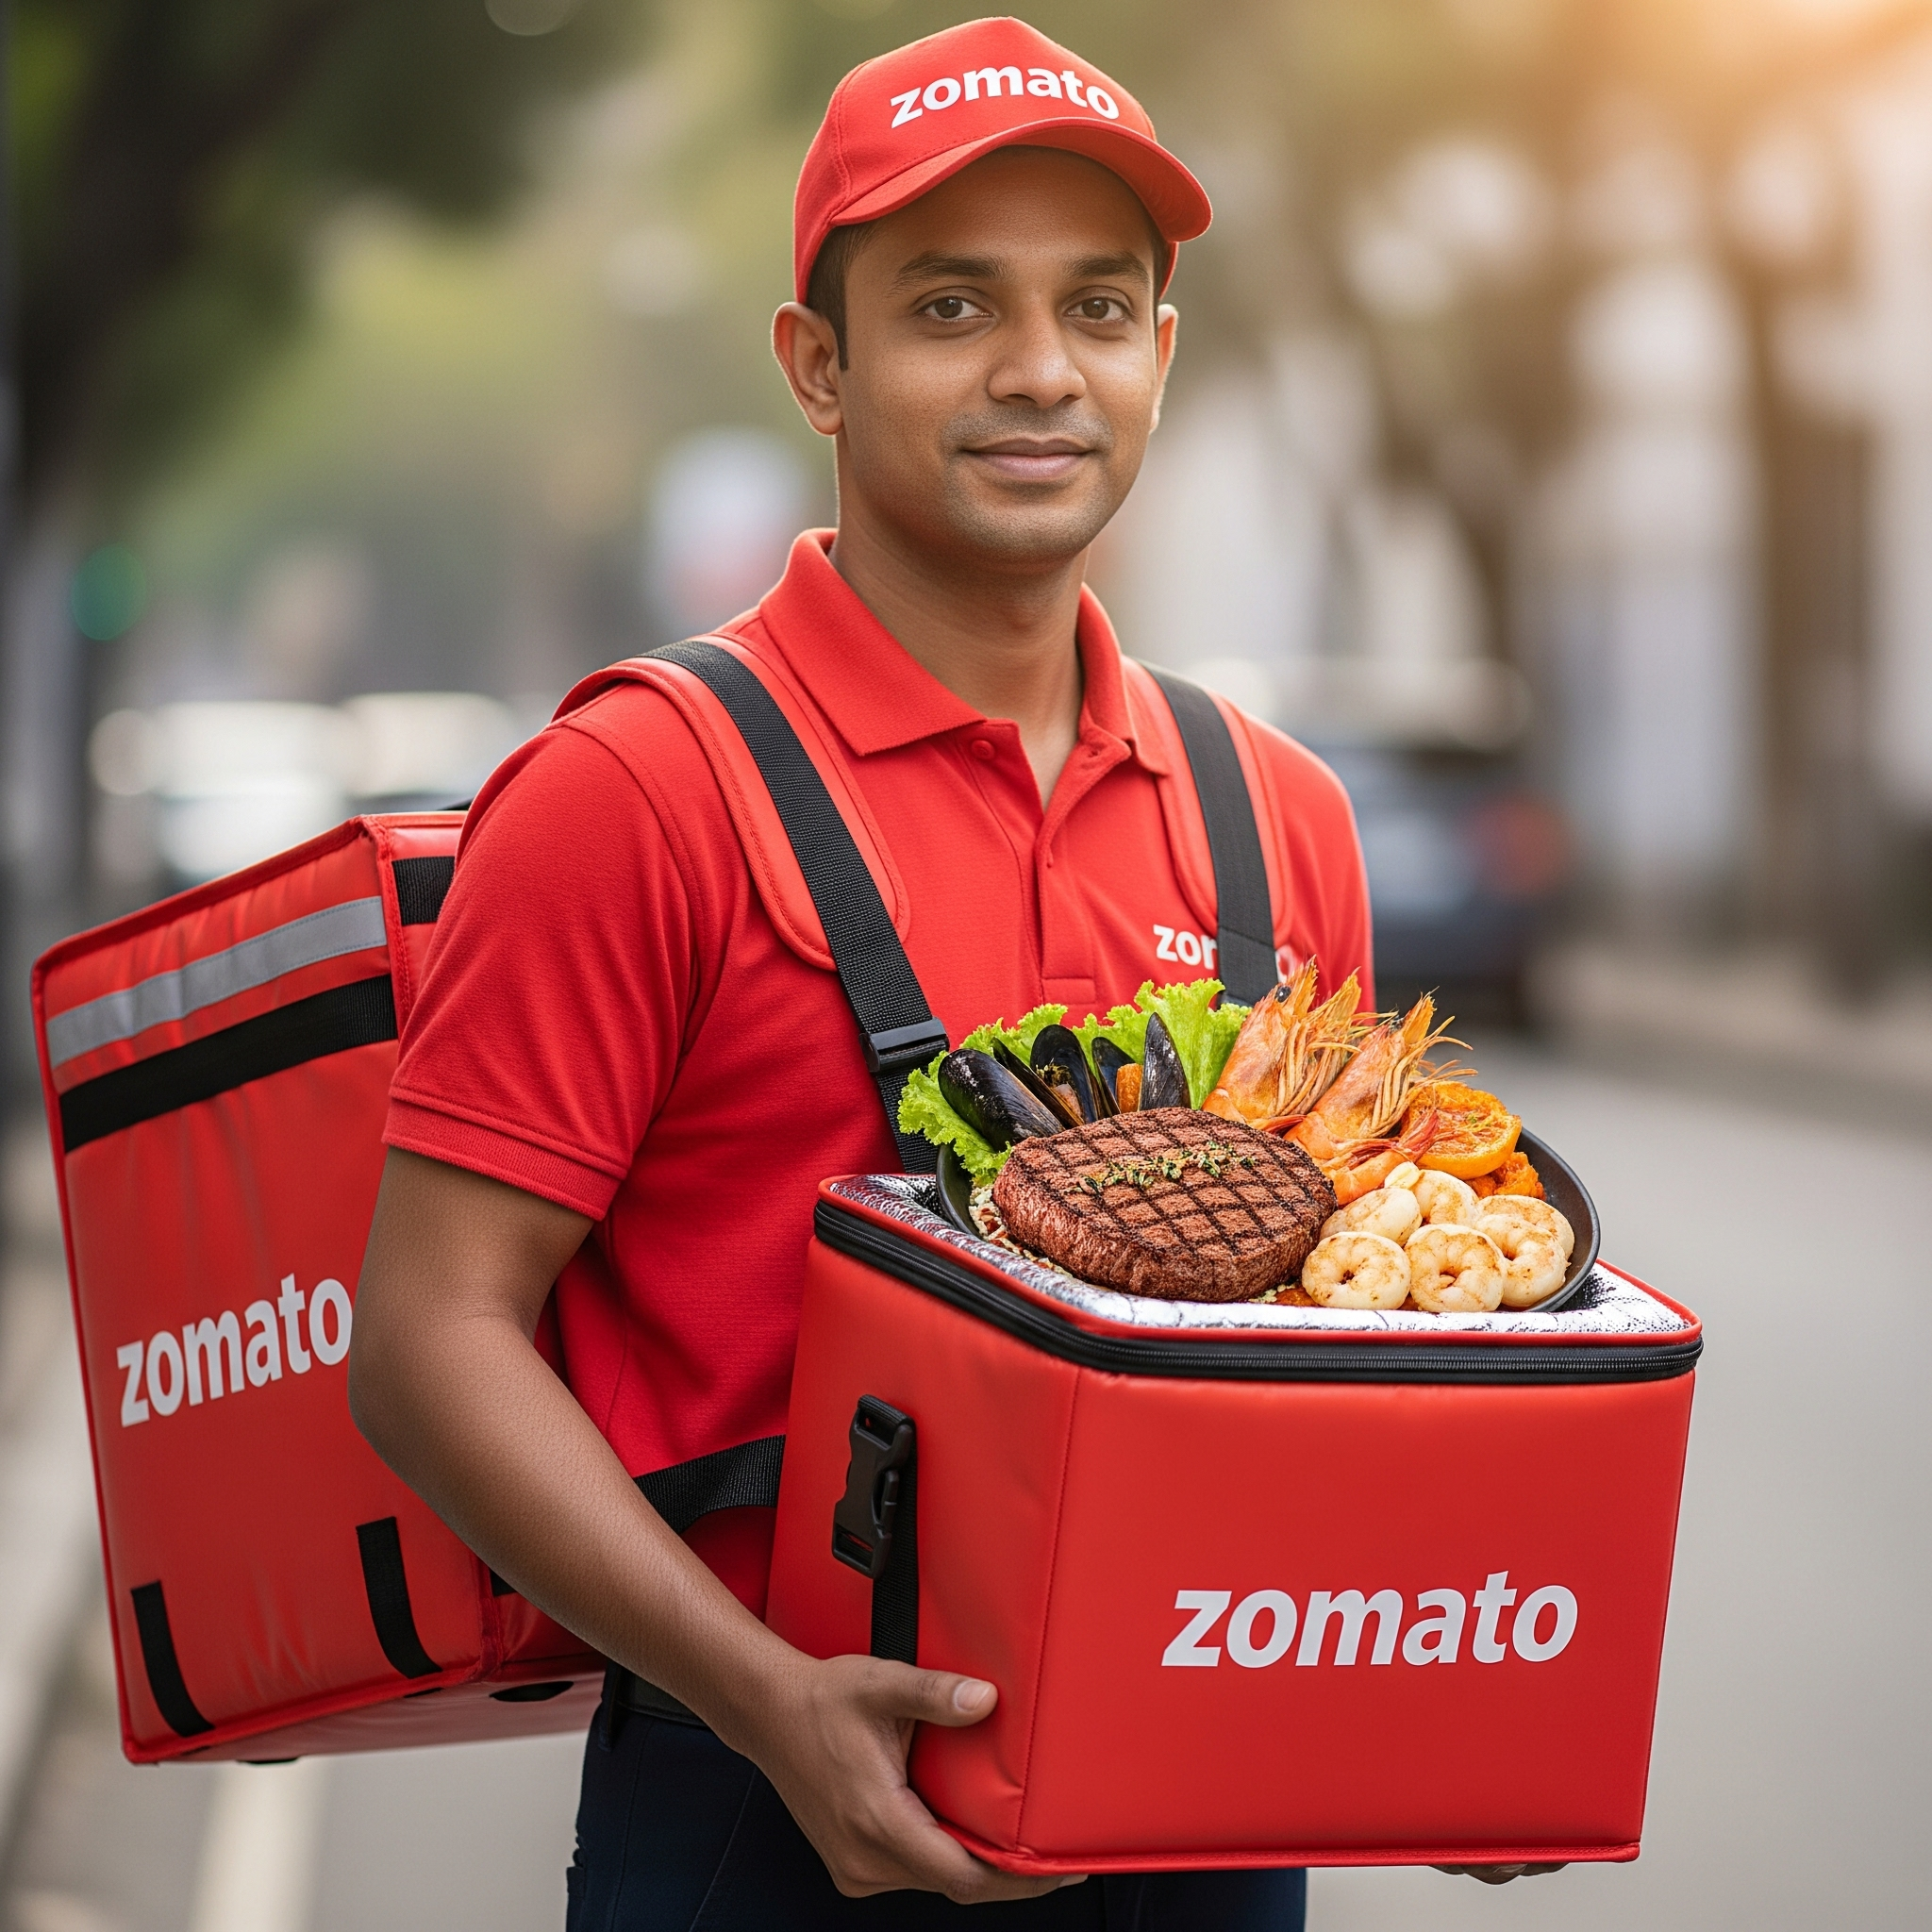
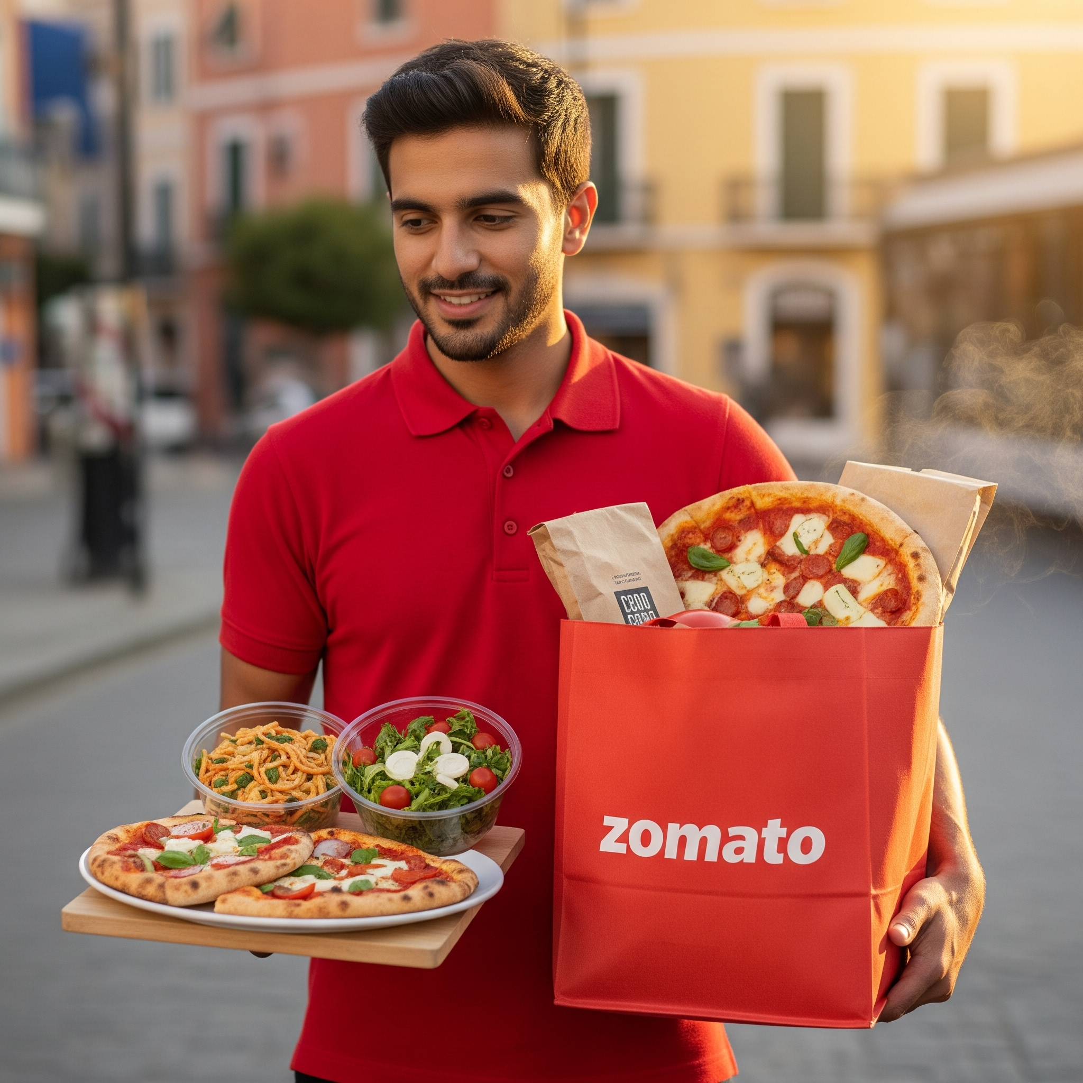
Strategic Focus: Popular Cuisine Offerings
Recommendation Integrate high-demand global cuisines — such as American, Steak, Seafood, Italian, Mediterranean, Bakery, and Pizza into all new restaurant openings.
Analytical Insight:
High-demand global cuisines attract and retain customers through broad appeal and consistent satisfaction.
Projected Business Outcomes:
Accelerated market entry and acceptance
Stronger initial customer feedback and satisfaction
Enhanced brand credibility and repeat patronage

Slide 17
Global Food Expenditure – Insights for Target Markets
Key Insights:
🇸🇬 Singapore – Highest average cost for two (₹269,322.9)
Requires a high-ROI strategy with premium positioning and strong cost control.
🇦🇺 Australia – Mid-range cost (₹49,973.88)
Balanced market for moderate investment with healthy returns potential.
🇨🇦 Canada – Low cost (₹12,536.7)
Low-risk entry point, allowing for gradual market penetration.
🇱🇰 Sri Lanka – Low cost (₹13,775.0)
Affordable entry with opportunities to build brand presence at minimal risk.
Strategic Takeaway:
While global costs vary widely, targeting low-to-mid cost markets (Canada & Sri Lanka) allows Zomato to expand with minimal financial pressure, while selectively entering high-cost markets (Singapore) with a premium approach ensures profitability.

Slide 18
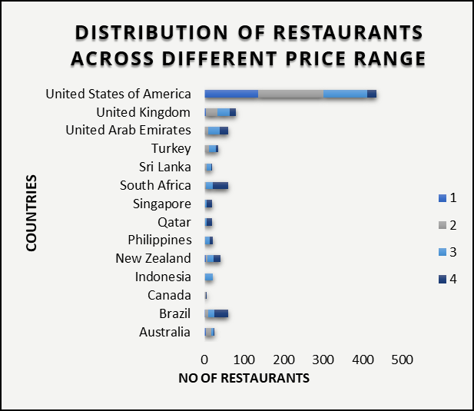
Competitive Positioning: Price Range Distribution
Recommendation: Analyzing the distribution of restaurants by price range in target countries to identify underserved segments.
Analytical Insight:
The bar chart reveals country-specific variations in restaurant price range distribution, indicating opportunities to target underserved price segments.
Business Impact
Targeted market entry based on local price dynamics
Optimized pricing strategies for new openings
Competitive positioning tailored to regional demand

Slide 19
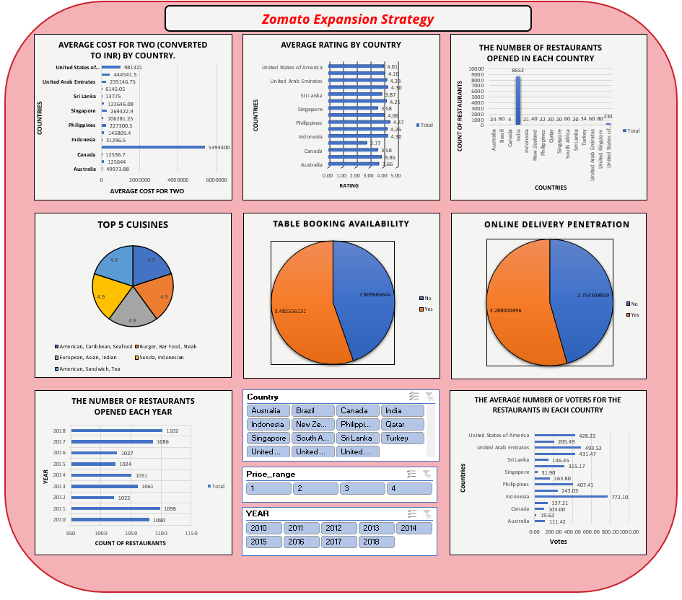

Slide 20
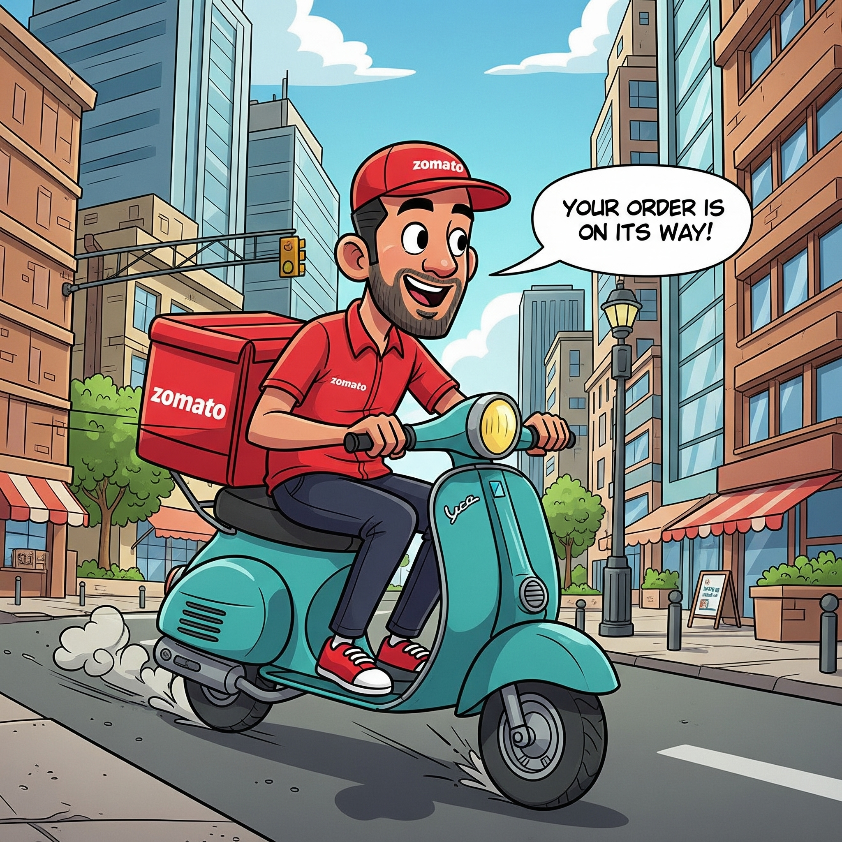
Conclusion
Our analysis outlines a clear roadmap for Zomato’s strategic expansion into high-potential yet less competitive markets—namely Canada, Singapore, Sri Lanka, and Australia. Success in these markets will hinge on launching with online delivery and table booking capabilities, which are proven to drive higher customer satisfaction and ratings. Aligning offerings with globally popular cuisines such as American, Steak, Seafood, and Italian will further enhance initial market traction. Importantly, data confirms that value and quality, not higher pricing, foster customer loyalty. Finally, adapting to each country’s unique expenditure landscape will be critical for sustaining profitability and operational efficiency.

Slide 21
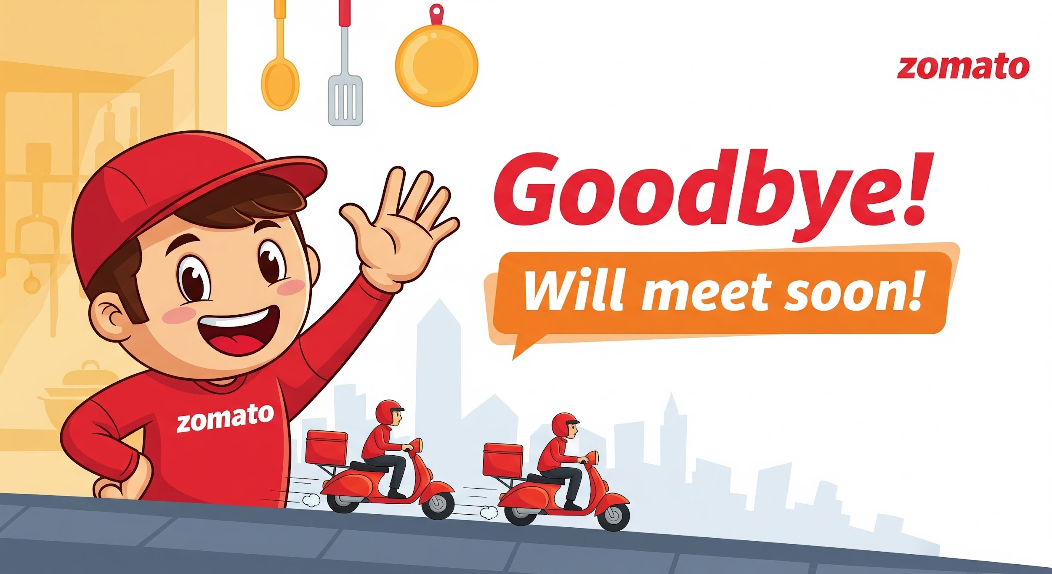
Acknowledgements and References
Acknowledgements:
I would like to extend my sincere gratitude to my mentors, Mr. Vijay Chandra Raj and Mr. Akhileswar Reddy, for their invaluable guidance and support throughout this project. Their insights and expertise were instrumental in shaping this analysis.
References:
Zomato Expansion Strategy Data (Internal Data Source)

